Slide 1
Sailpoint IdentityIQ
Total Technology

Slide 2
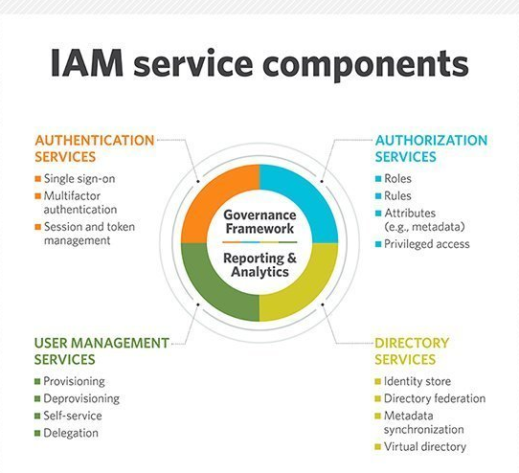
Identity & Access Management
What is Identity & Access Management?
A framework of policies and technologies for ensuring that the proper people in an enterprise have the appropriate access to technology resources.

Slide 3
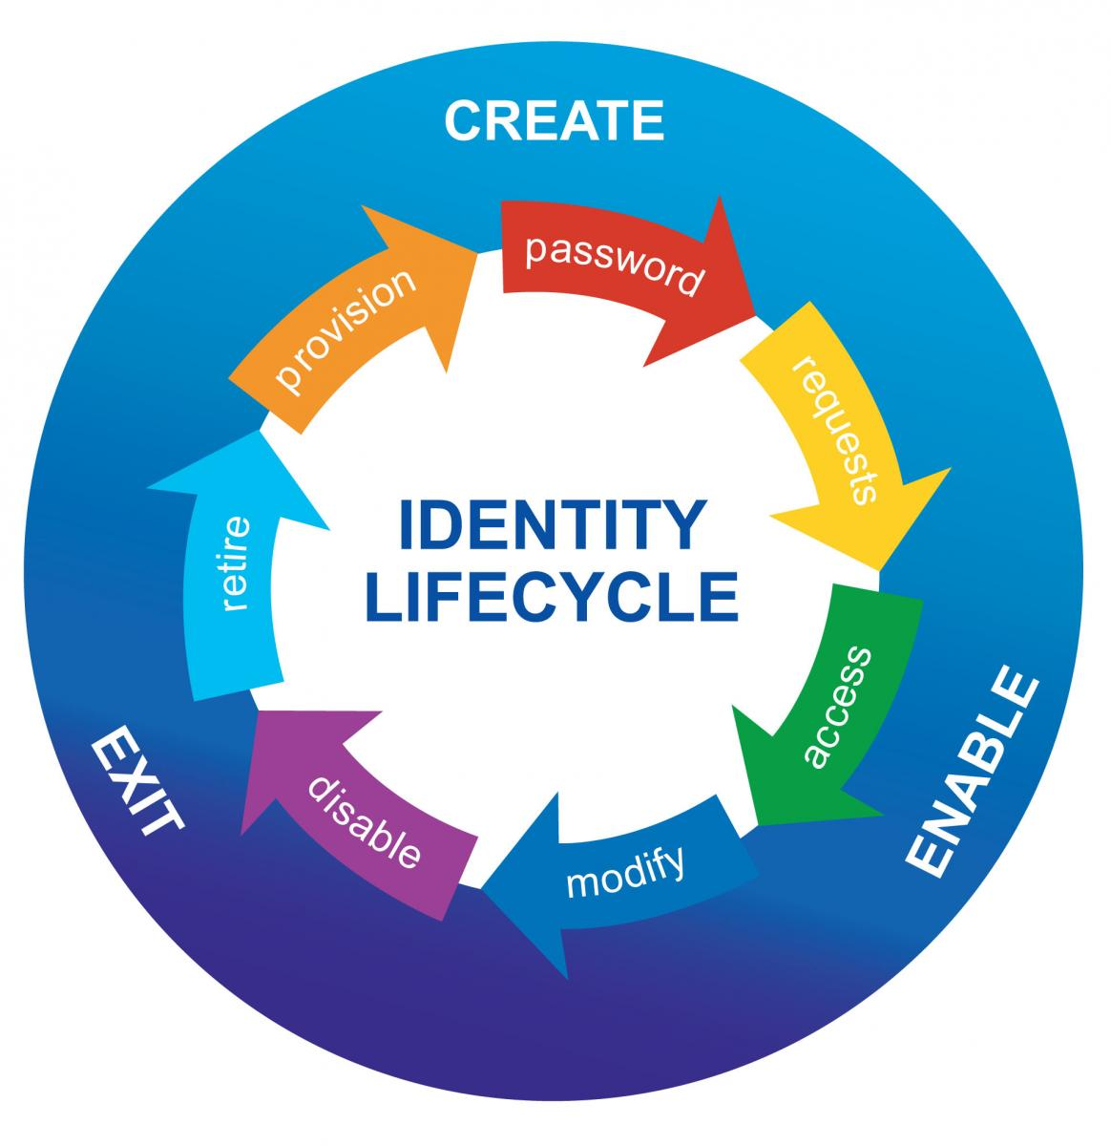
Identity & Identity Lifecycle
What is Identity?
A digital identity is the body of information about an individual, organization or electronic device that exists online.

Slide 4
Identity Governance & Administration Components
Workflow Management
Entitlement Management
Identity Lifecycle Management
Access Request
Access Certification
Auditing
Reporting & Analytics

Slide 5
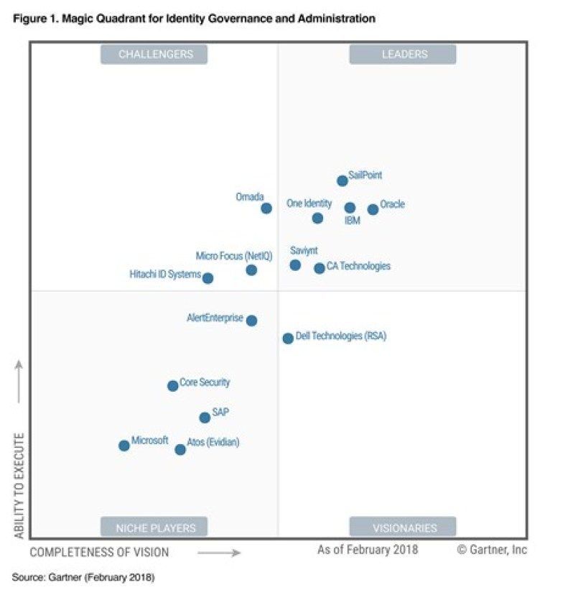
Introduction to Sailpoint IdentityIQ

Slide 6
IdentityIQ 8.0 Installation
Supported Platform
Operating System
IBM AIX 7.1 and 7.2
Red Hat Linux (RHEL) 7.5 and 7.6
Oracle Linux (using RHE Kernel Mode) 7.5 and 7.4
SUSE Linux 12.1 and 12.2
Windows Server 2016 and 2019
Solaris 10 and 11
CentOS 7.5 and 7.6
Application Server
Apache Tomcat 9.0 and 8.5
Oracle WebLogic 12.2.1.x
IBM WebSphere 9.0
Jboss Enterprise EAP 7.2
IBM WebSphere Liberty 18.0.0.4
Databases
IBM DB2 10.5 and 11.1
MySQL 5.7 and 8.0
MS SQL Server 2016 and 2017
Oracle 18c, 12cR2
AWS Aurora
Azure SQL
Java Platform
Oracle JDK 8 and 11
AdoptOpenJDK 8 and 11 for Windows
Red Hat OpenJDK 8 and 11 for Linux
Workflow Management
Entitlement Management

Slide 7
Sailpoint IIQ Rule
Other types of Rule
Certification Rule
Notification/Assignment Rule
Identity and Account Mapping Rule
What is Rule?
Types of Rule?
Connector Rule
PreIterate Rule
Buildmap Rule
Aggregation/Refresh Rule
Correlation Rule
IdentityCreation Rule
ManagerCorrelation Rule
Provisioning Rule
BeforeProvisioning Rule
AfterProvisioning Rule
JDBCProvision Rule

Slide 8
Sailpoint IIQ Role
What is Entitlement?
What is Role? Relationship with Entitlement
Types of Role
Organizational Role
Business Role
IT Role
Entitlement
Role based provisioning

Slide 9
Sailpoint IIQ Role Based Provisioning
What is Provisioning?
What is Role Based Provisioning?
JDBC Connector App
Provisioning Policy
Provisioning Rule
Implement Role Based Provisioning

Slide 10
Sailpoint IIQ Deployment Accelerator
A plugin for the popular and free IDE Eclipse that provides several features designed to make configuring and managing IdentityIQ easier.
Benefits/Features:
Integration with multiple IdentityIQ environments (Dev, Test, QA, etc.)
Direct deployment, with token substitution, into any connected environment
Direct export/extract, with token replacement, from any connected environment
Steps:
Install plug-in to Eclipse
http://sailpoint.github.io/epiiq
Configure the server side workflow
https://sailpoint.github.io/epiiq/Workflow-Importer.xml
Create IIQ Project
Importing Objects from an IdentityIQ System
Deploying objects into an IdentityIQ System

Slide 11
Sailpoint IIQ Active Directory Integration
What is Active Directory?
A set of services run in Windows Server
Active Directory Services:
Domain Services (AD DS)
Lightweight Directory Services (AD LDS)
Certificate Services
Federation Services
Rights Management Service
Active Directory Objects: User, Computer, Contact, Printer, Shared Folder, Groups etc.

Slide 12
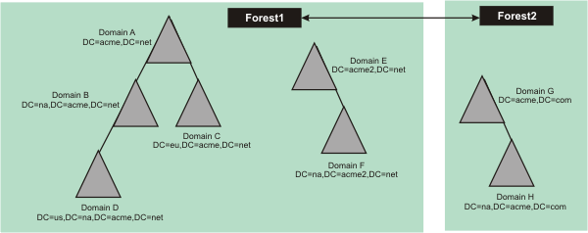
Sailpoint IIQ Active Directory Integration
Forest, Tree, Domain
Global Catalog Server
Store location of all objects in the forest

Slide 13
Sailpoint IIQ Active Directory Integration
Installation & Registration IQService
Copy IQService.zip file from identityiq_home/WEB-INF/bin/win into a new directory
Unzip IQService.zip
Run following in cmd to install:
IQService.exe –i
Start service:
IQService.exe –s
Other command options:
-? | h — This help output
-d — run in console mode
-i — Install a service
-k — stop the service
-u: Uninstall the service. Removes the service components and clears the registry
entries
-v — Print version information

Slide 14
Sailpoint IIQ Active Directory Provisioning
Role-Based Provisioning without Entitlement Provision
Run IQService
Configure Active Directory application, set Provisioning Policy
Create a business role. Attach a Provisioning Policy
Configure LCM Provisioning workflow to change approval process
Request access through Manage User Access
Role-Based Provisioning with Entitlement Provision
Run IQService
Configure Active Directory application, set Provisioning Policy
Aggregate groups from Active Director to create Entitlements
Create IT roles from the Entitlements
Create Business roles and assign corresponding IT roles as ‘Required Role’
Create Business role’s Provisioning Policy

Slide 15
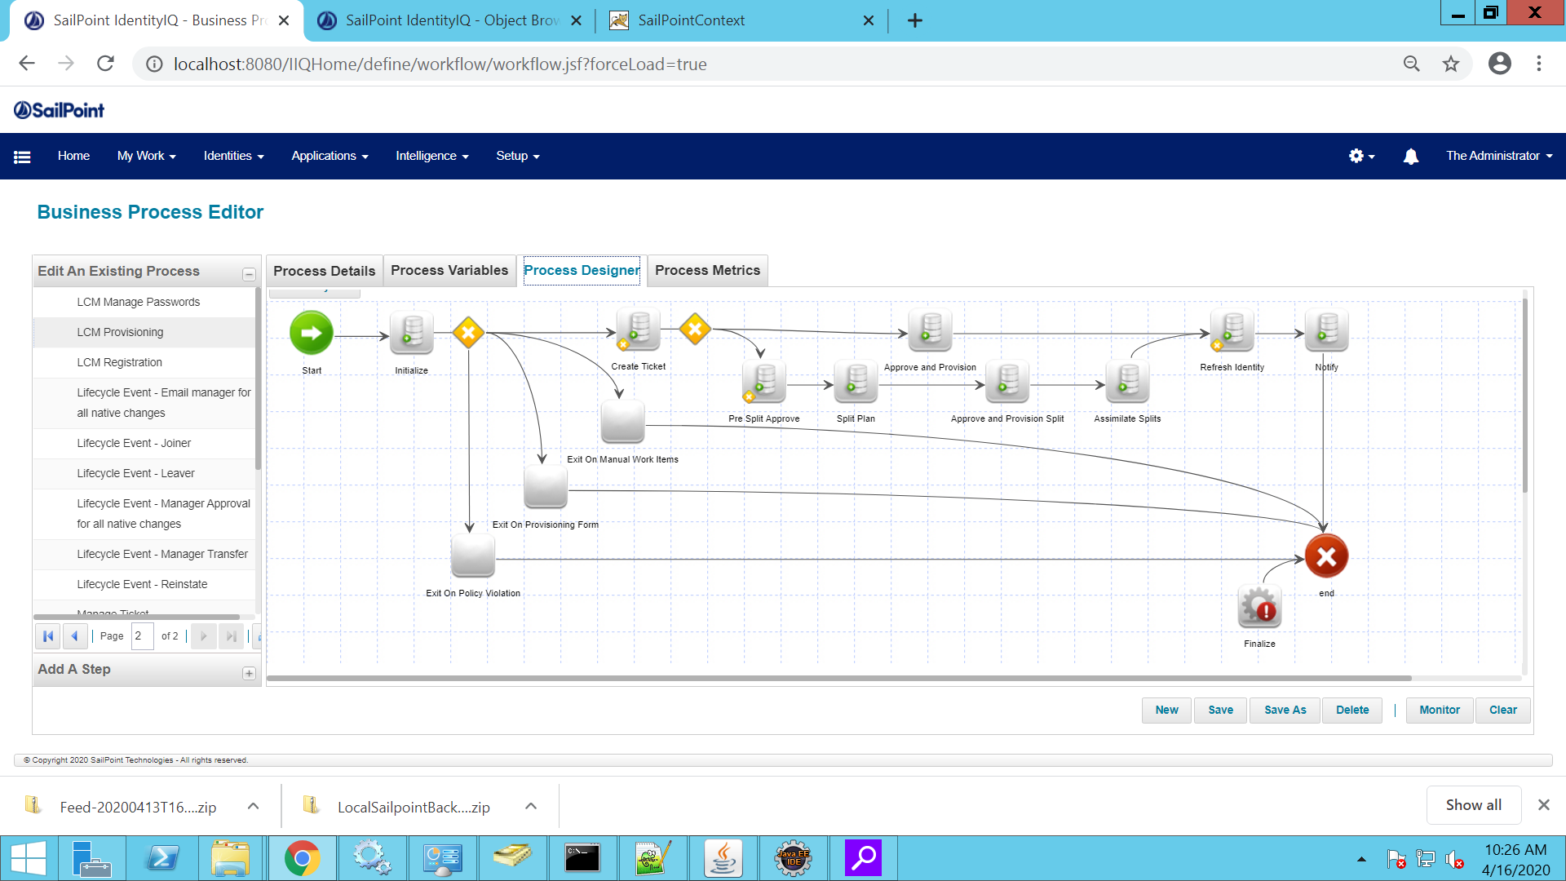
Sailpoint IIQ Workflow/Business Process Overview
Role based and Life Cycle Event based
Life Cycle Event
Joiner
Mover
Leaver
What is Workflows in Sailpoint?
XML file containing a set of steps to perform specific task
Triggering Events:
Role creation or modification
Account Group creation or modification
Identity update
Identity refresh
Identity correlation
Deferred role assignment, de-assignment
Deferred role activation, deactivation
Any Lifecycle Manager event
Any Lifecycle Event (marked by changes to an Identity's attributes)

Slide 16
Sailpoint IIQ Workflow/Business Process Overview
Workflow Trigger
Lifecycle Manager Requests
Lifecycle Events
Non-LCM-related Events
Identity Attribute Change
Policy Violation
LCM Types
Identity Lifecycle
Identity Update
LCM Identity
LCM Provisioning
LCM Registration
Subprocess

Slide 17
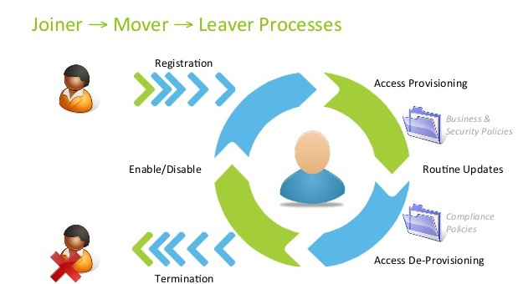
Sailpoint IIQ AD Birthright Provisioning through Lifecycle Event
Birthright Provisioning
Role
Joiner Lifecycle Event
Hybrid
Identity Lifecycle Management
Process of managing the identities from their creation to the
end
Join event, Mover event, Leaver event

